Slide 1


DEPARTMENT OF ARTIFICIAL INTELLIGENCE AND DATA SCIENCE
SCHOOL OF COMPUTING
10214AD602 MINOR PROJECT -II
WINTER SEMESTER(2024-2025)
REVIEW-II
“AI-Powered Storyboard Creator: Generative Text-to-Image Tool for Movies, Games and Ads ”
SUPERVISED BY
PRESENTED BY
Mrs. JAYSHREE. S
1 J.NAVADEEP (VTU NO.23403)(REG NO.22UEAD0040)
2 G.HARSHITTH (VTU NO.24248)(REG NO.22UEAD0011)
3.M.SIDDESWAR REDDY (VTU NO.21541)(REG NO.22UEAD0037)

Slide 2
OVERVIEW
ABSTRACT
OBJECTIVE
INTRODUCTION
LITERATURE REVIEW (SOFT COPY OF PAPERS TO BE LINKED AS HYPERLINK)
DESIGN AND METHODOLOGIES
IMPLEMENTATION
TESTING
INPUT AND OUTPUT
INCLUDE DEMO VIDEO-1 (Till REVEW-1)
INCLUDE DEMO VIDEO-2(Complete Implementation of Project)
CONCLUSION
WEB REFERENCES LINK (TILL REVIEW DATE ALL LINKS TO BE INCLUDED DAY WISE)
PLAGIARISM REPORT OF PPT
REFERENCES

Slide 3
ABSTRACT
Introduction: The rapid evolution of artificial intelligence has transformed creative industries, enabling innovative tools for content generation in movies, games, and advertising.
Purpose: This project aims to develop an AI-powered storyboard creator that converts textual descriptions into high-quality visual storyboards, streamlining pre-production processes.
Method: Utilizes advanced generative AI models, combining natural language processing for text interpretation and text-to-image synthesis for visual output, trained on diverse cinematic and artistic datasets.
Result: The tool successfully generates detailed, contextually accurate storyboard images from text inputs, reducing manual effort and enhancing creative workflows.
Conclusion: The AI-powered storyboard creator offers a scalable, efficient solution for visualizing narratives, with potential to revolutionize storytelling across multiple media industries.

Slide 4
OBJECTIVES
The objective of the AI-Powered Storyboard Creator project is to develop a generative AI tool that automates the creation of visual storyboards from textual descriptions. The tool aims to:
Automate the manual and time-consuming process of transforming scripts into illustrative frames for movies, games, and ads.
Utilize cutting-edge Natural Language Processing (NLP) and text-to-image generation models to produce accurate and high-quality visuals.
Provide an intuitive platform for creators to visualize and refine their ideas instantly.
Support a wide range of styles and genres, from cinematic realism to stylized game art, ensuring versatility across industries.
Incorporate contextual understanding to align visuals with narrative tone, character details, and scene-specific requirements.
Enable rapid prototyping of concepts, empowering creators to experiment with multiple visual interpretations efficiently.
Leverage continuous learning capabilities to improve output quality based on user interactions and evolving creative trends.

Slide 5
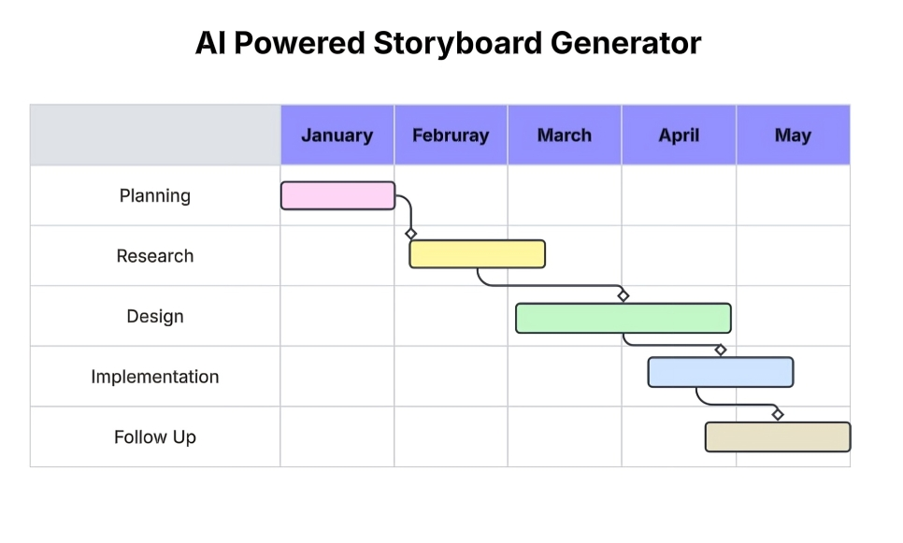
TIMELINE OF THE PROJECT
GANTT CHART

Slide 6
INTRODUCTION
The tool combines generative AI capabilities with a user-friendly interface, enabling users to input text prompts and receive dynamic, high-quality storyboard frames tailored to their specifications. Beyond simple image generation, it offers features like frame count monitoring, adjustable picture quality, style options (e.g., black-and-white, cinematic, or comic book aesthetics), and additional creative enhancements to ensure the output is both functional and visually striking. The goal is to streamline workflows, foster collaboration, and unlock new creative possibilities by making professional-grade storyboarding accessible to everyone, regardless of artistic ability.
The creative industries of movies, games, and advertising rely heavily on the ability to transform ideas into compelling visual narratives, a process that traditionally demands significant time, skill, and resources. The AI-Powered Storyboard Creator emerges as a groundbreaking solution to address these challenges by automating the manual and time-consuming task of converting scripts into illustrative frames. Leveraging cutting-edge Natural Language Processing (NLP) and advanced text-to-image generation models, this tool delivers accurate, high-quality visuals that bring textual descriptions to life. Designed as an intuitive platform, it empowers creators to instantly visualize and refine their concepts, fostering a seamless creative workflow. It’s continuous learning ability ensures it adapts to user needs and evolving trends, making it a versatile and transformative asset for storytelling across multiple media domains.

Slide 7
LITERATURE REVIEW
Sl.No | Author’s Name | Paper name and publication details | Year of publication | Main content of the paper
1 | Xu, T., Zhang, P., et al. | "AttnGAN: Fine-Grained Text to Image Generation with Attention Mechanisms," IEEE Transactions on Pattern Analysis and Machine Intelligence (TPAMI), vol. 41, no. 8, pp. 1929-1943 | 2019 | Introduces AttnGAN, a model that generates detailed images from text using attention mechanisms to focus on specific words, applicable to storyboard visualization.
2 | Ramesh, A., Pavlov, M., et al. | "Zero-Shot Text-to-Image Generation," IEEE Conference on Computer Vision and Pattern Recognition (CVPR), pp. 11593-11603 | 2021 | Presents DALL-E, a zero-shot text-to-image model using transformers, enabling high-quality image generation for creative industries like movies and games.

Slide 8
Sl.No | Author’s Name | Paper name and publication details | Year of Publication | Main content of the paper
3 | Li, Y., Zhang, R., et al | "StoryGAN: A Sequential Conditional GAN for Story Visualization," IEEE Conference on Computer Vision and Pattern Recognition (CVPR), pp. 6329-6338 | 2019 | Proposes StoryGAN, a generative adversarial network (GAN) for sequential image generation from text, ideal for creating coherent storyboards for narratives.
4 | Zhang, H., Koh, J. Y., et al. | "Cross-Modal Contrastive Learning for Text-to-Image Generation," IEEE Conference on Computer Vision and Pattern Recognition (CVPR), pp. 833-842 | 2021 | Introduces a contrastive learning approach to align text and image features, improving the accuracy of text-to-image synthesis for advertising and games.
5 | Ho, J., Jain, A., et al. | "Denoising Diffusion Probabilistic Models," IEEE Transactions on Neural Networks and Learning Systems (TNNLS), vol. 33, no. 10 | 2022 | Describes diffusion models for high-quality image generation, a foundational technique for modern text-to-image tools used in creative storyboard creation.

Slide 9
DESIGN AND METHODOLOGIES
MODULE 1: Text Processing and Scene Interpretation
MODULE 2: Text-to-Image Generation Engine
MODULE 3: Style and Genre Adaptation
MODULE 4: Sequential Narrative Alignment
MODULE 5: User Interface and Real-Time Editing
MODULE 6: Integration and Export Compatibility

Slide 10
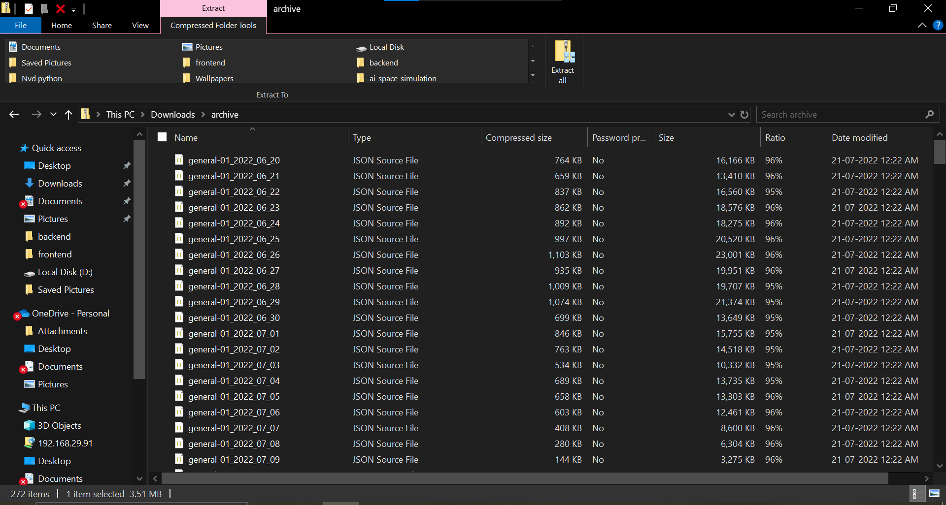
MODULE 1: Text Processing and Scene Interpretation
Step:1 Collection of data
The initial phase of Module 1 involves gathering a comprehensive dataset to train the Natural Language Processing (NLP) models for text processing and scene interpretation. The dataset includes a diverse collection of scripts, screenplays, and narrative descriptions from movies, games, and advertisements, paired with corresponding storyboard images where available. Additionally, annotated text data with labeled entities (e.g., characters, actions, settings, and emotions) is curated to enable the AI to understand narrative context. Publicly available datasets like the MovieScript dataset, game narrative repositories, and advertising copy libraries are utilized, alongside custom datasets created.

Slide 11
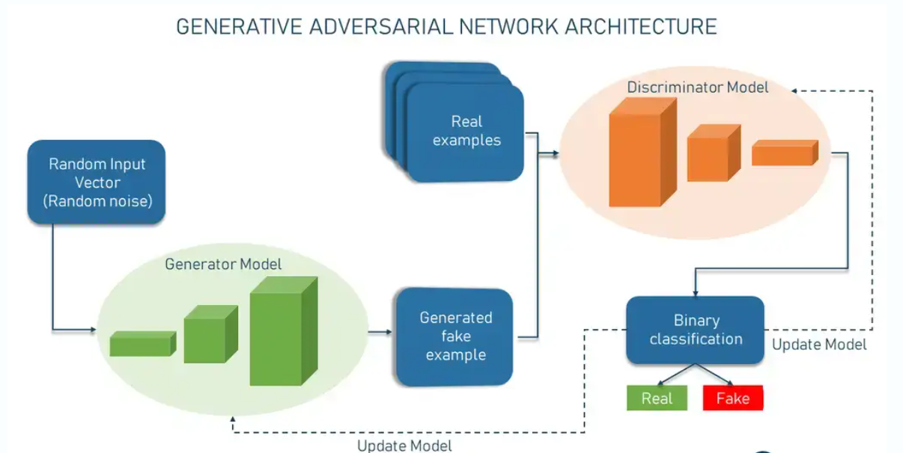
Step 2:Scene Interpretation
Following the collection of data, this step focuses on interpreting the textual descriptions to extract meaningful scene components for storyboard generation. Advanced Natural Language Processing (NLP) techniques are employed, utilizing transformer-based models such as BERT and RoBERT to analyze the input scripts. The process involves several sub-tasks:
Entity Extraction, where key elements like characters, actions, settings, and objects are identified (e.g., "A hero stands on a cliff at sunset" identifies "hero" as the character, "stands" as the action, "cliff" as the setting, and "sunset" as the time).
Sentiment and Tone Analysis, to capture the emotional context of the scene (e.g., "determined" or "tense").
Dependency Parsing, to understand the relationships between entities and actions for accurate scene composition.

Slide 12
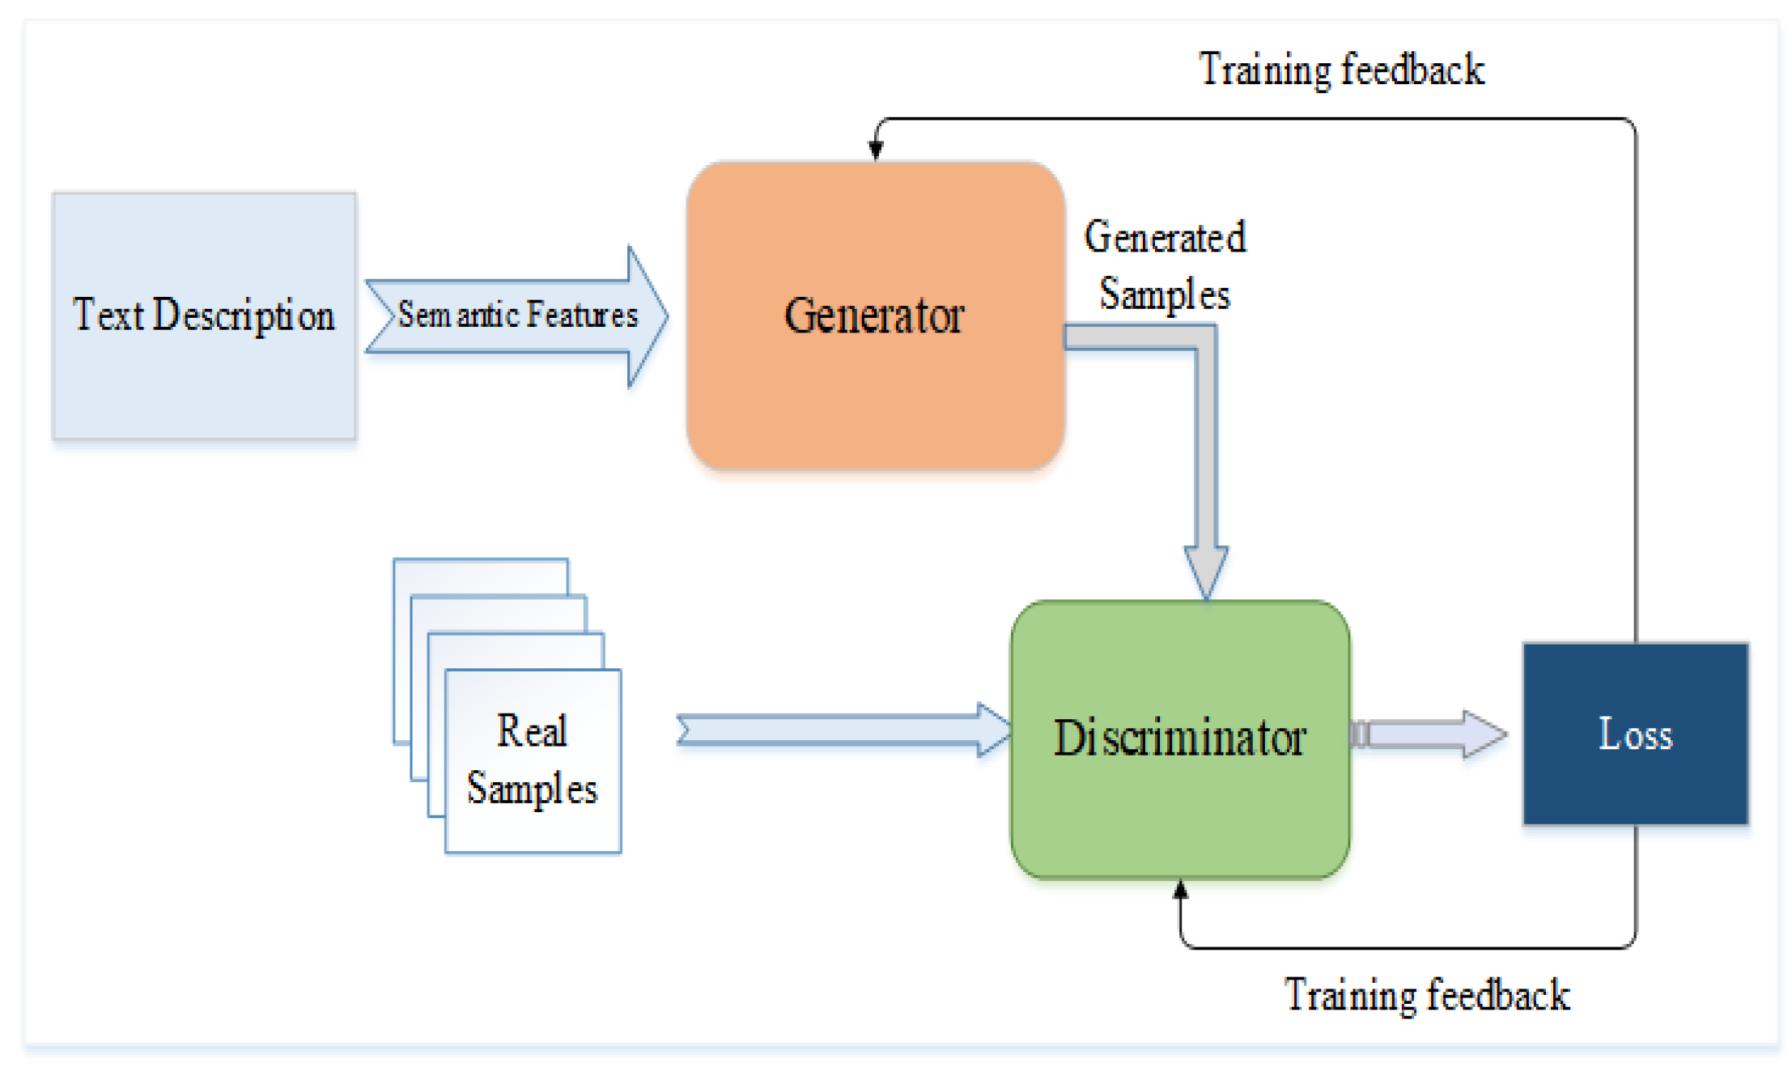
MODULE 2- Text-to-Image Generation Engine
This module forms the core of the AI-Powered Storyboard Creator, responsible for transforming the structured textual data from Module 1 into high-quality visual storyboard frames. It leverages state-of-the-art generative AI models to bridge the gap between text and imagery, ensuring that the generated visuals accurately reflect the narrative context for applications in movies, games, and advertisements. It consists of processes like extraction of semantic features from text, generator, discriminator, trained samples with loss data and real samples.

Slide 13
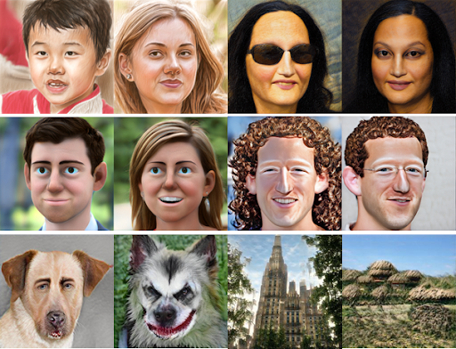
MODULE 3: Style and Genre Adaption
This module ensures that the AI-Powered Storyboard Creator can adapt its visual outputs to a wide range of styles and genres, catering to the diverse needs of movies, games, and advertisements. By enabling the tool to generate images in styles such as cinematic realism, stylized game art, or sleek advertising visuals, this module enhances the flexibility and applicability of the storyboard creator. The process is broken down into the following steps:
Step 1: Style Dataset Curation
Step 2: Style Embedding and Conditioning
Step 3: Style Transfer and Fine Tuning

Slide 14
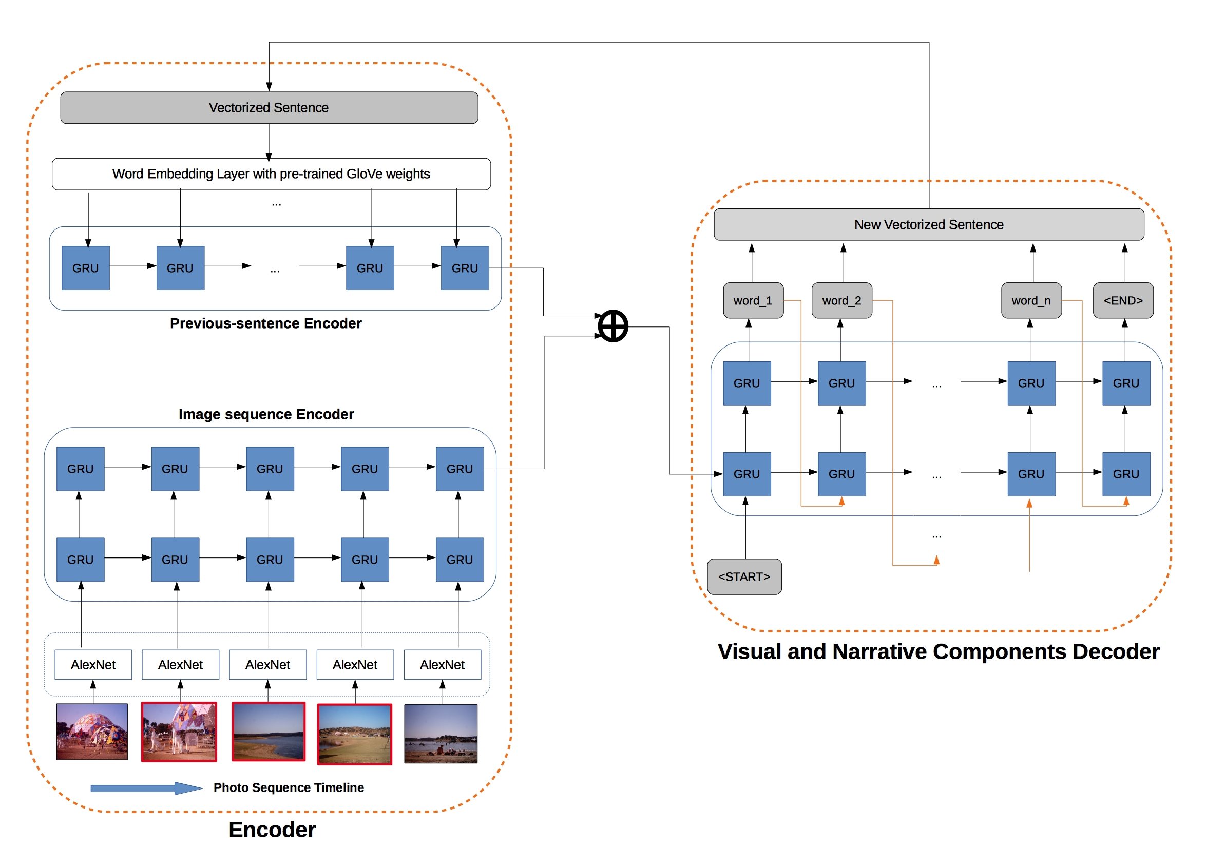
MODULE 4: Sequential Narrative Alignment
This module ensures that the AI-Powered Storyboard Creator generates visually coherent storyboard sequences by maintaining narrative continuity across multiple frames, a critical requirement for storytelling in movies, games, and advertisements. By aligning the generated images with the progression of the script, this module preserves the logical flow of actions, settings, and emotions, creating a seamless visual narrative.

Slide 15
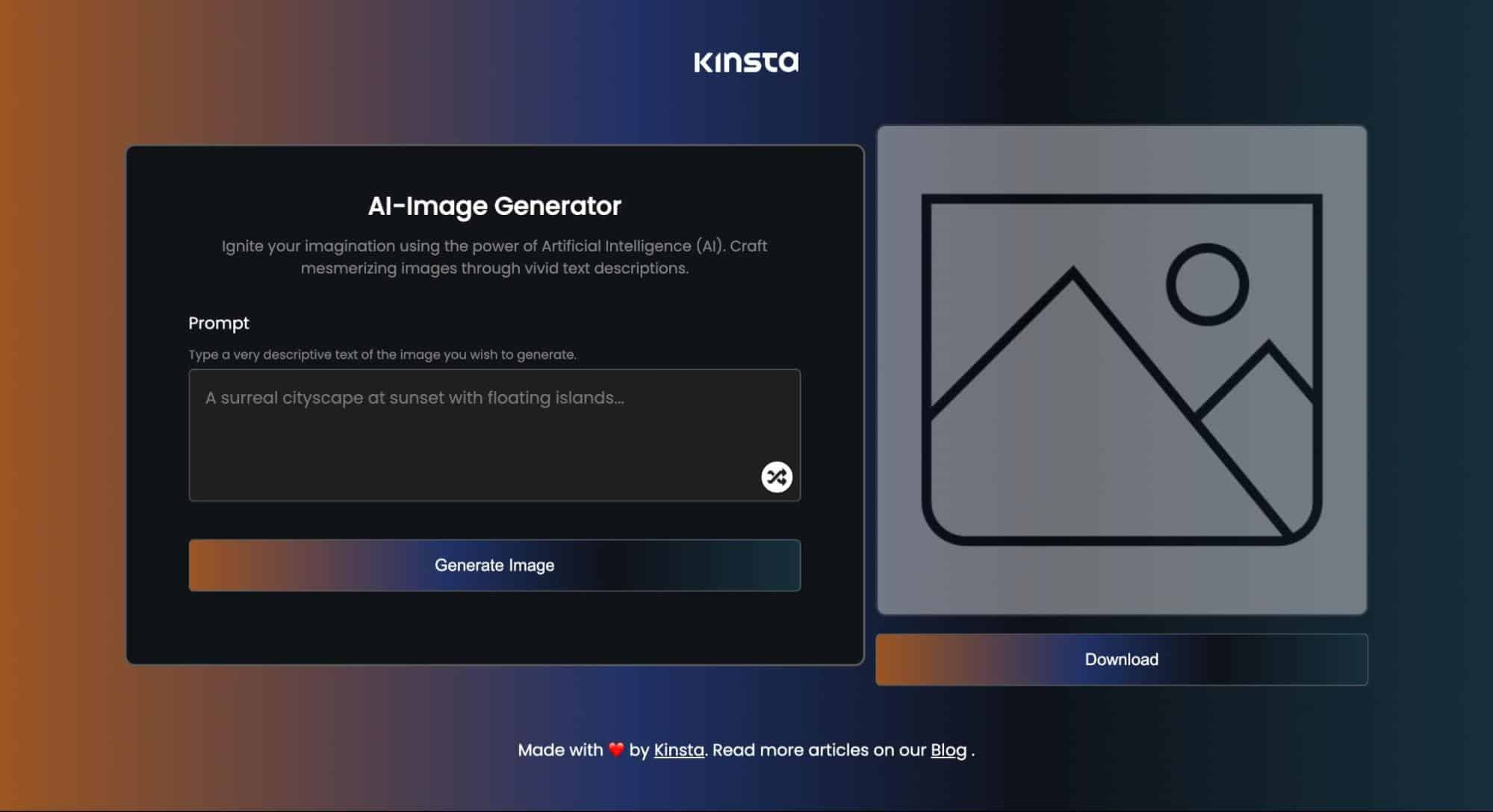
MODULE 5:User Interface and Real Time Editing
This module focuses on developing an intuitive and user-friendly interface for the AI-Powered Storyboard Creator, enabling creators to input scripts, visualize generated storyboards, and make real-time adjustments to the visual output. Designed to enhance the creative workflow for professionals in movies, games, and advertising, this module ensures seamless interaction with the AI system while providing tools for iterative refinement of storyboard frames. The process is broken down into the following steps:
Step 1: Interface Design and Layout
Step 2: Script Input and Visualization
Step 3: Feedback Integration and Collaboration

Slide 16
MODULE 6:Integration and Export Combatibility
This module ensures that the AI-Powered Storyboard Creator seamlessly integrates with existing industry tools and workflows, allowing creators in movies, games, and advertising to incorporate generated storyboards into their production pipelines. By providing export compatibility with standard formats and enabling integration with popular software, this module enhances the tool’s practicality and accessibility for professional use. The process is broken down into the following steps:
Step 1: Format Standardization and Export Options
Step 2: Integration with Industry Software
Step 3: Cloud-Based Collaboration and Sharing
Step 1: The first step focuses on enabling the export of generated storyboards in industry-standard formats to ensure compatibility with existing workflows. The system supports exporting storyboards as individual image files (e.g., PNG, JPEG) for each frame
Step 2: In this step, the system is designed to integrate with popular pre-production and creative software used in the movie, game, and advertising industries. This includes tools like Adobe Story, Final Draft, Celtx, and storyboard-specific software such as Storyboard Pro. The integration is achieved through API development, allowing the AI-Powered Storyboard Creator to export data directly into these platforms.
Step 3: To facilitate teamwork, this step incorporates cloud-based features for storing, sharing, and collaborating on storyboards. The system integrates with cloud platforms like Google Drive, Dropbox, and Microsoft OneDrive, allowing users to save their projects online and share them with team members.

Slide 17
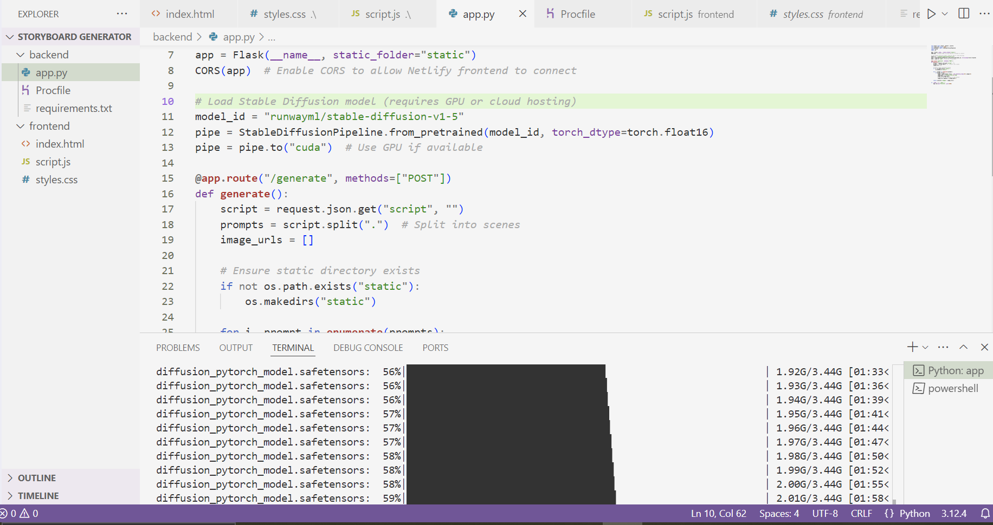
Step 4: Working Algorithm (Transformers)
For this project, Transformers like Stable Diffusion models are used for denoising diffusion probabilistic models to generate high-quality, photorealistic images from text. The algorithm starts with random noise and iteratively refines it into a coherent image by minimizing the difference between the noisy image and the target distribution, conditioned on the text embedding.

Slide 18
IMPLEMENTATION
Architecture Diagram
Data –Flow Diagram
Use Case Diagram
Class Diagram
Activity Diagram
Sequence Diagram
Collaboration Diagram(If applicable)
E-R Diagram
It’s a sample only and may vary according to the project

Slide 19
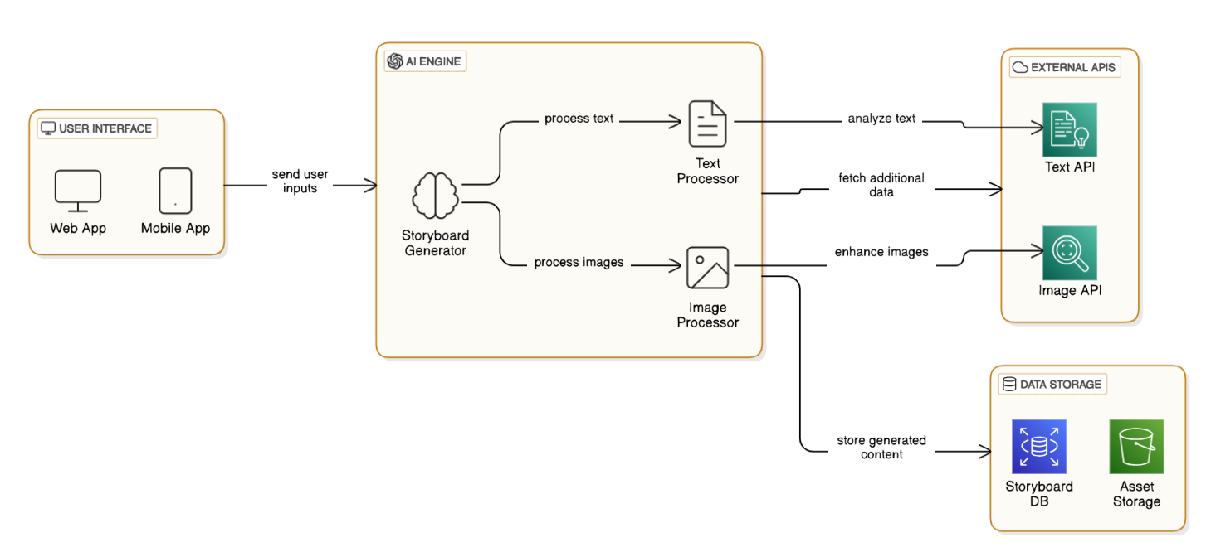
Architecture Diagram
This diagram represents the architecture of an AI-powered Storyboard Generator. It consists of four main components:
User Interface (UI)
AI Engine
External APIs
Data Storage

Slide 20
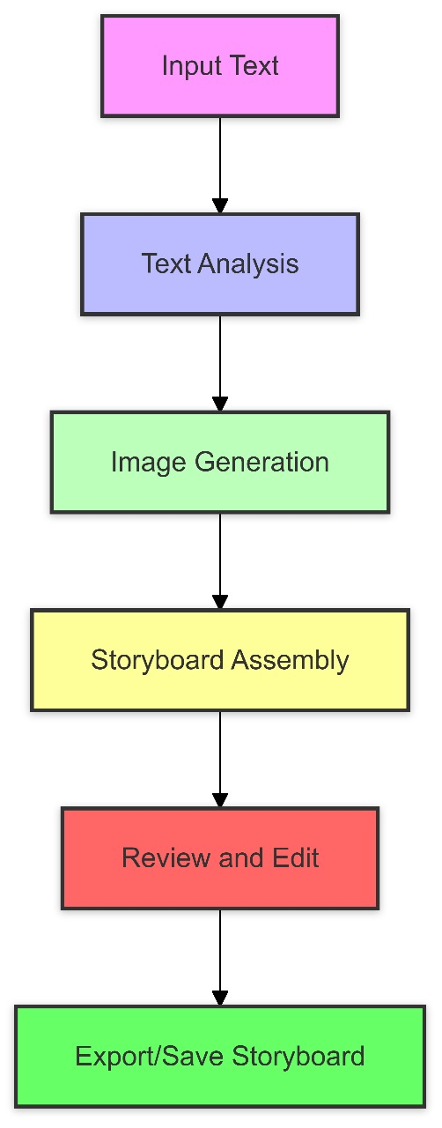
Data –Flow Diagram
The user provides a text input, which could be a script, a description, or prompts for generating a storyboard.
The system processes the input text using Natural Language Processing (NLP) that identifies key elements like characters, scenes, and actions.
Based on the analyzed text, the system generates images using models like stable diffusion of DALL-E to create relevant visuals.
The generated images are arranged in a structured format to form a storyboard. This step ensures the correct sequence of scenes based on the story flow.
The final storyboard is saved or exported in a preferred format (PDF, PNG, etc.). It can be stored in a Storyboard Database or Asset Storage for later use.

Slide 21
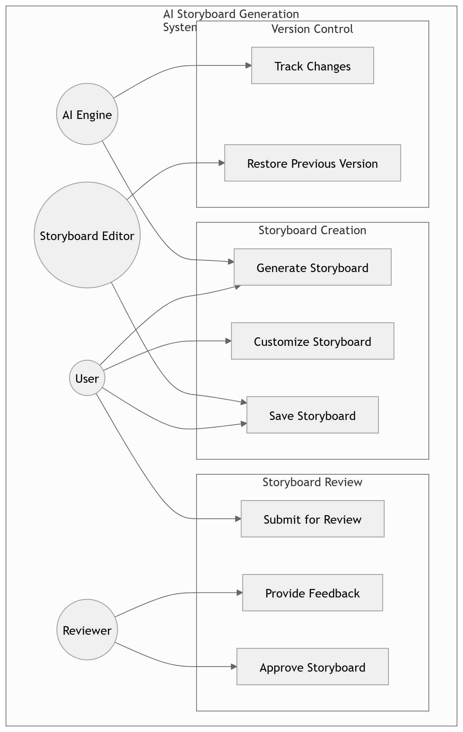
Use Case Diagram

Slide 22
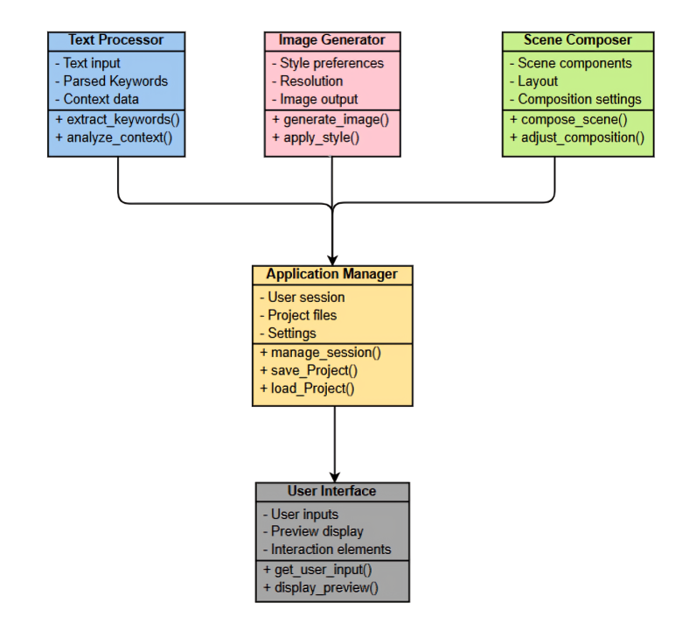
Class Diagram

Slide 23
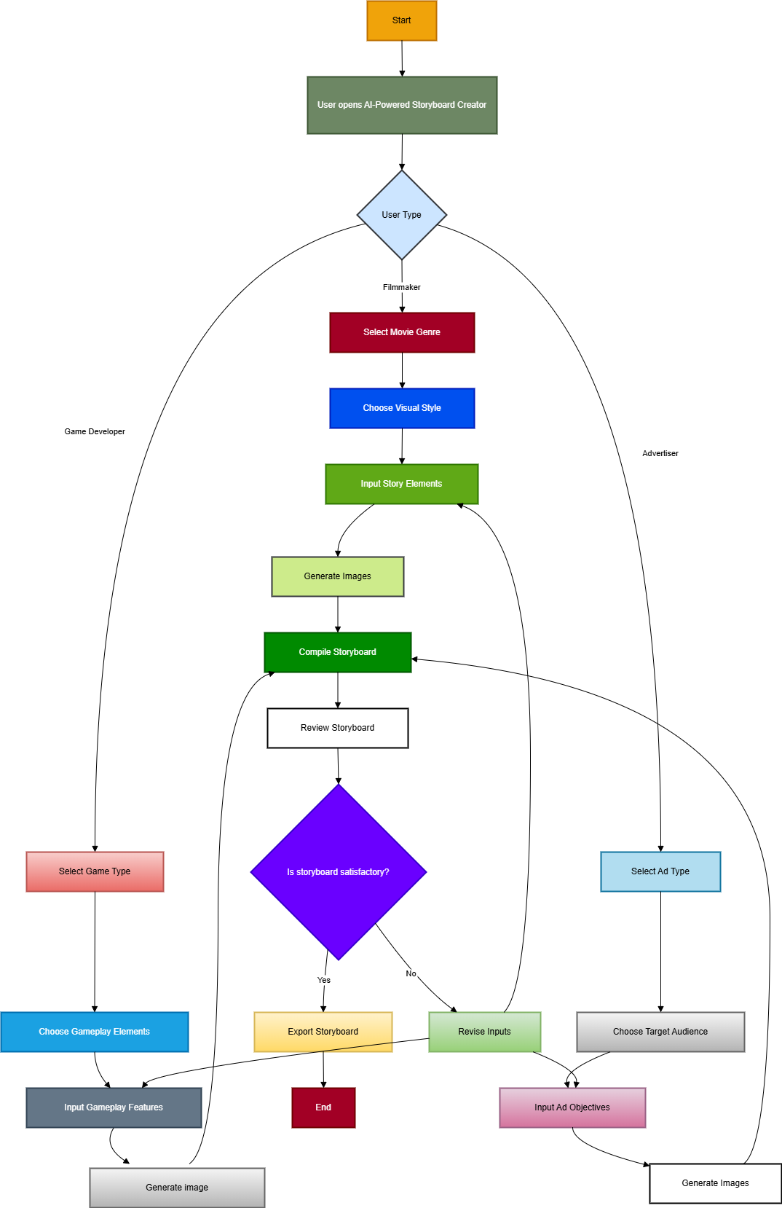
Activity Diagram

Slide 24
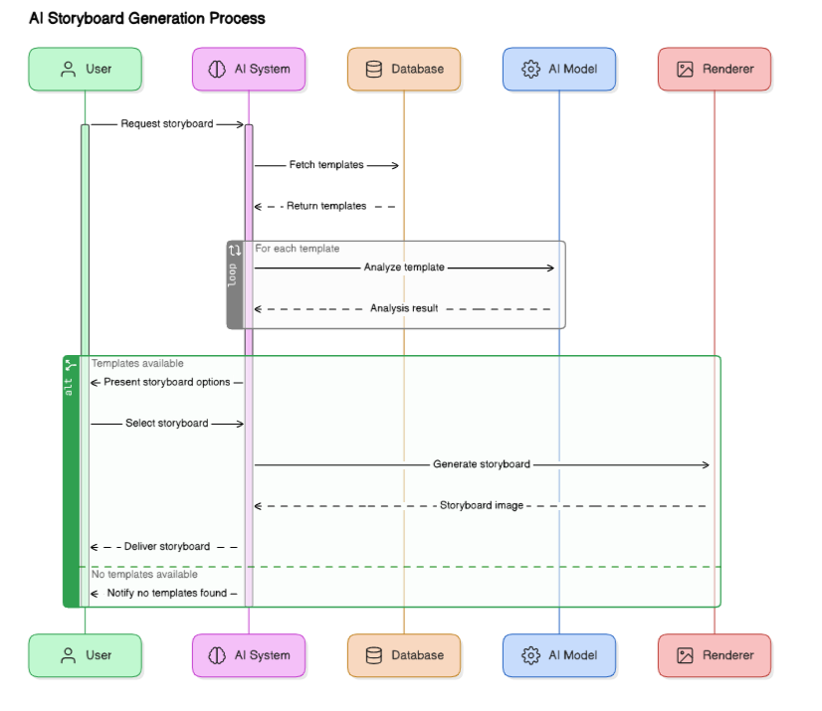
Sequence Diagram

Slide 25
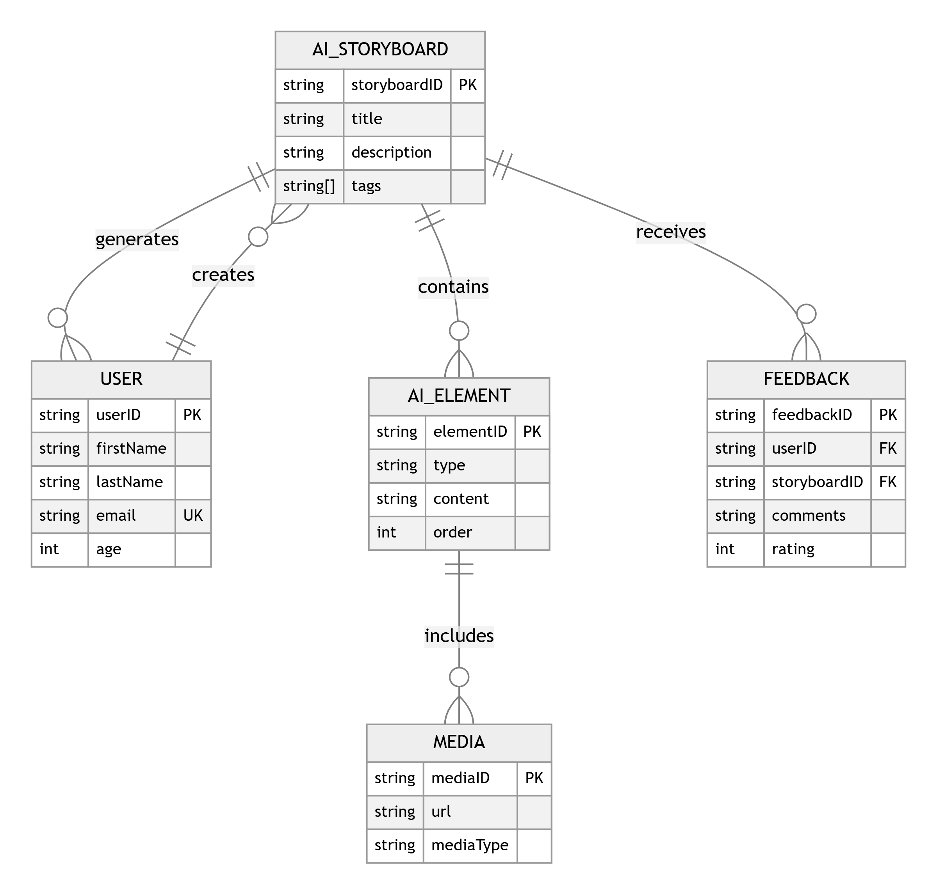
E-R Diagram

Slide 26
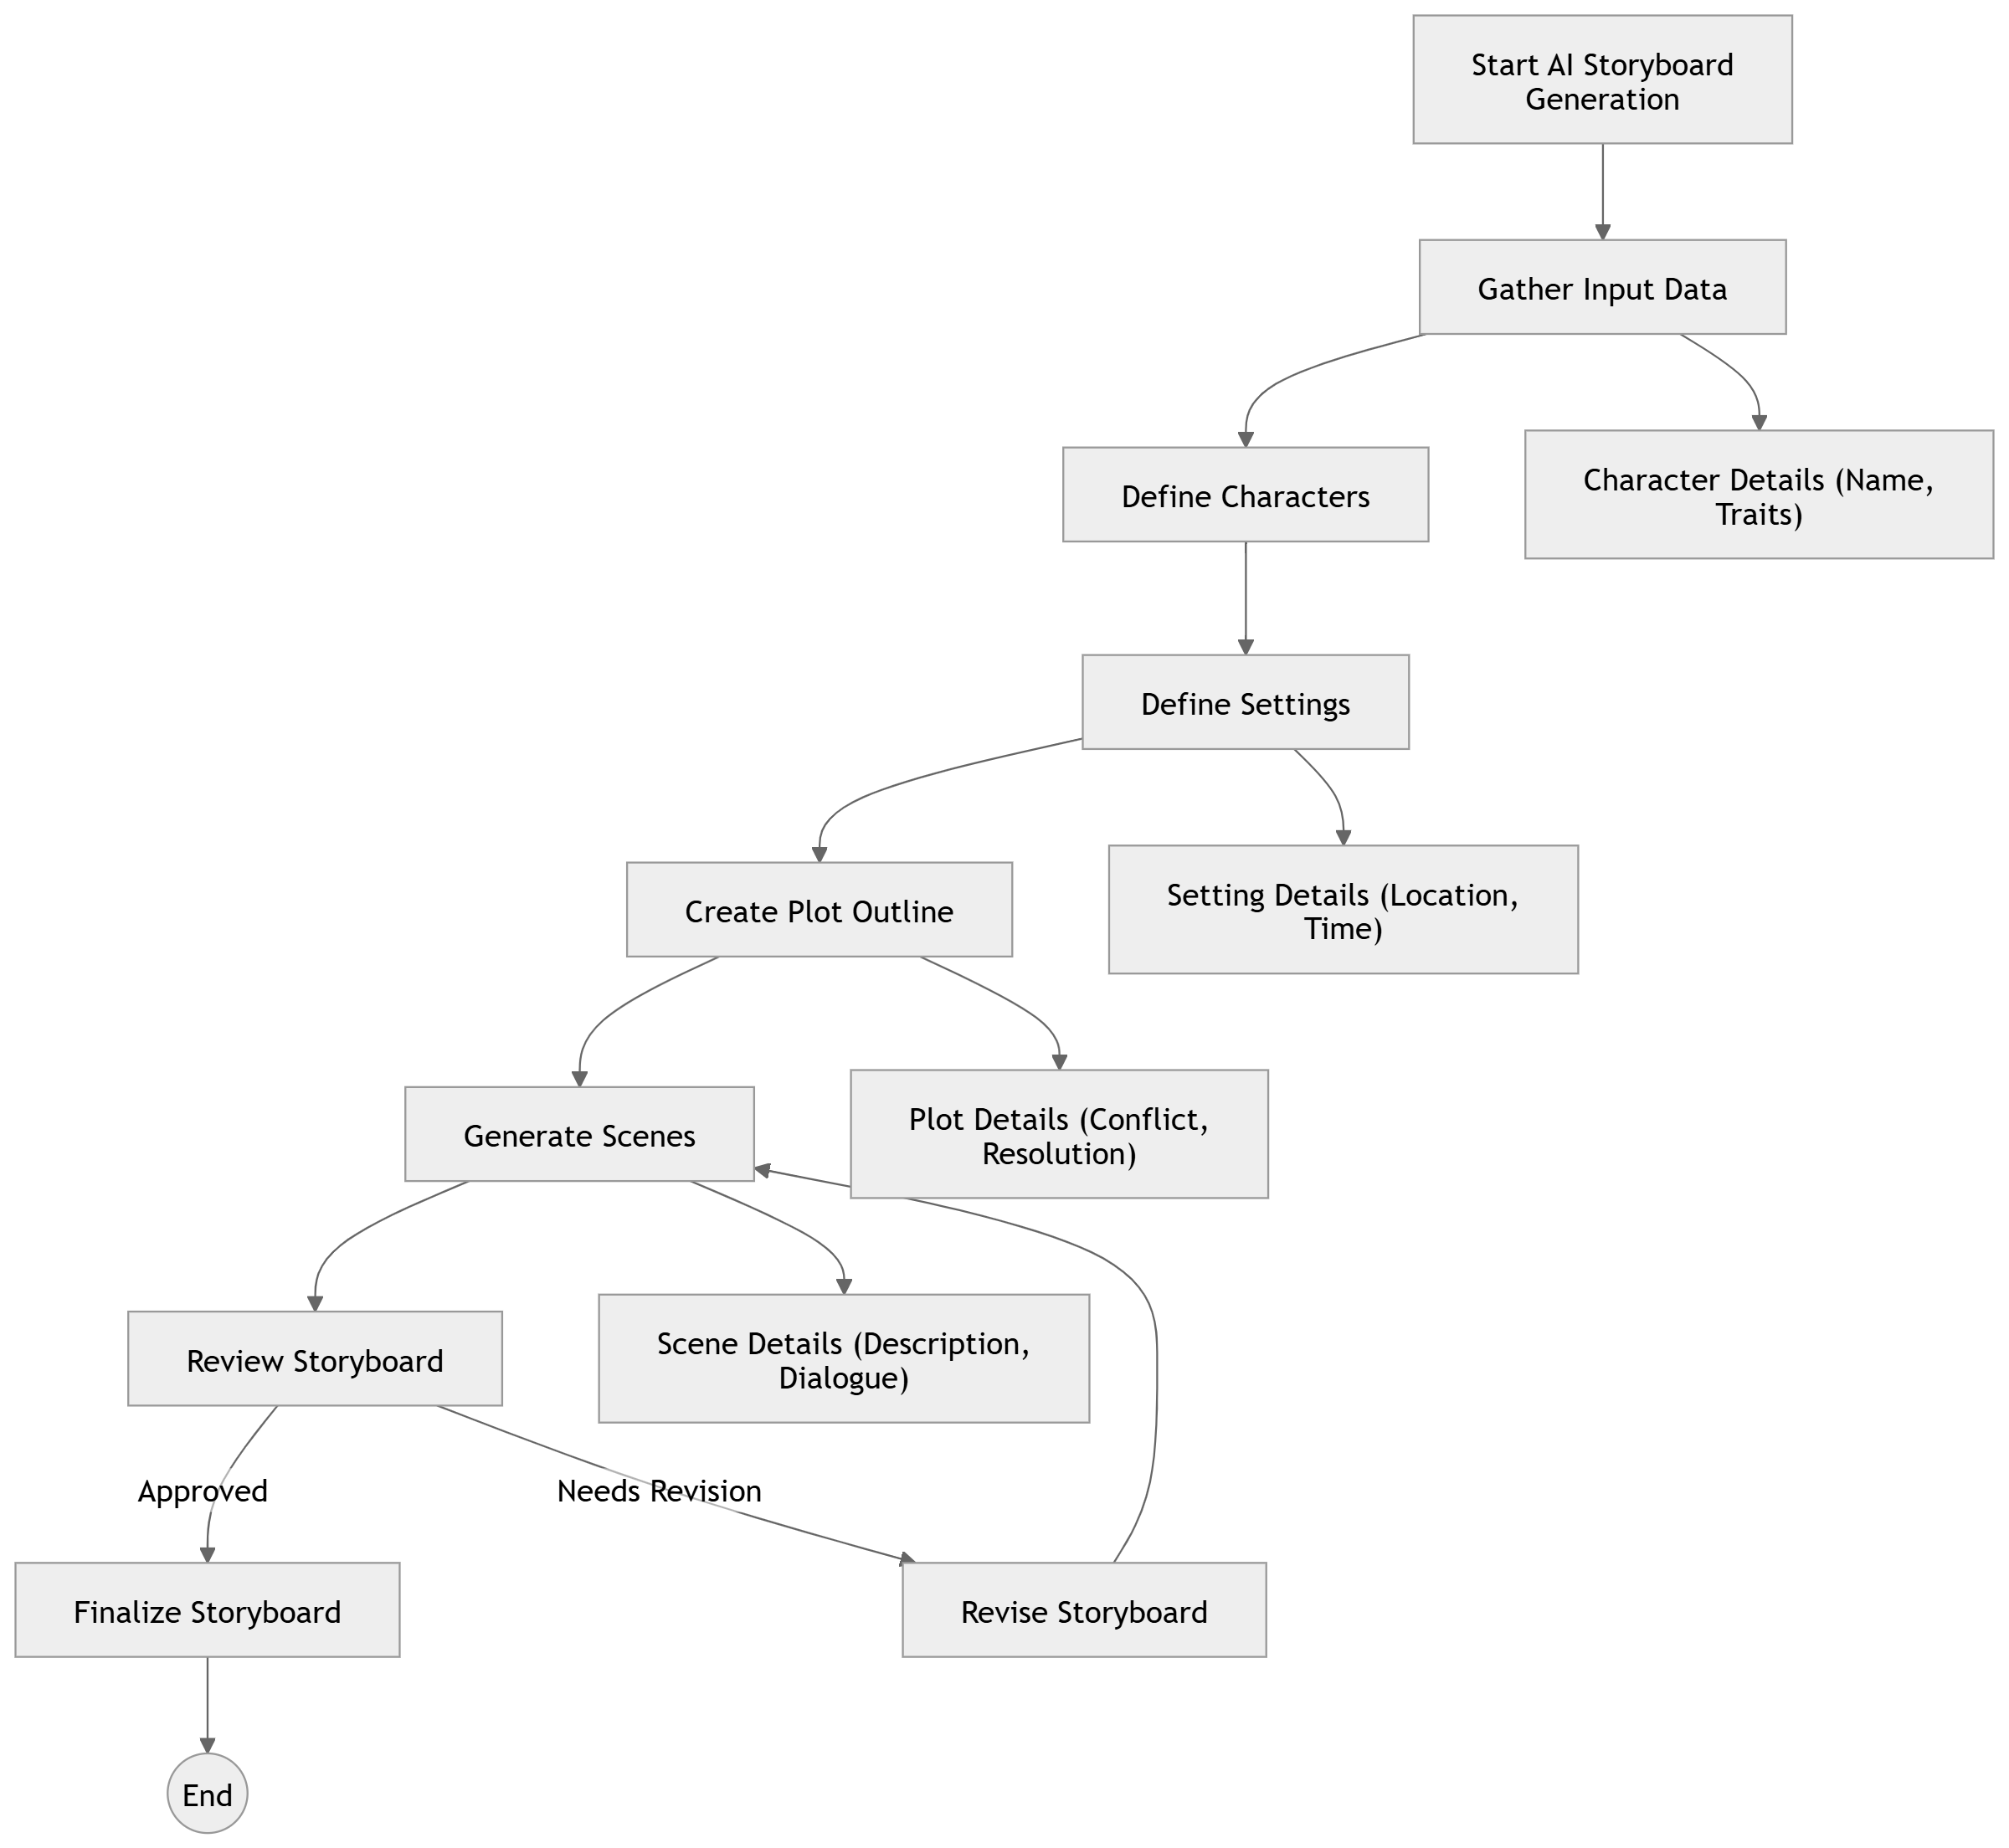
Collaboration Diagram(If applicable)

Slide 27
TESTING
UNIT TESTING
INTEGRATION TESTING
FUNCTIONAL TESTING
WHITE BOX TESTING
BLACK BOX TESTING

Slide 28
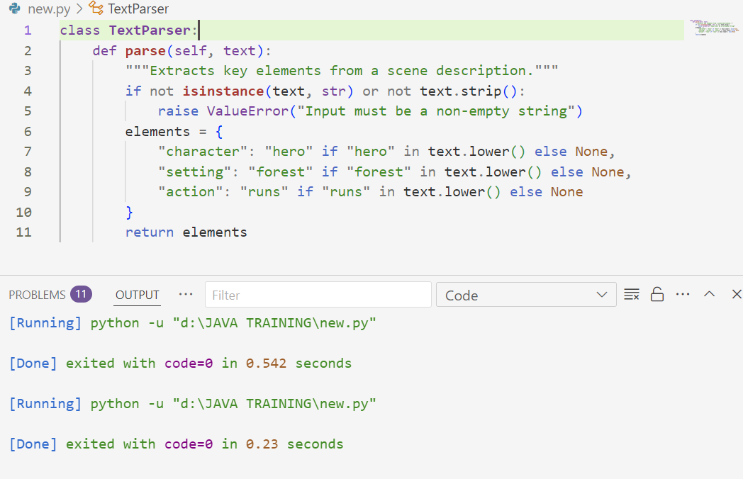
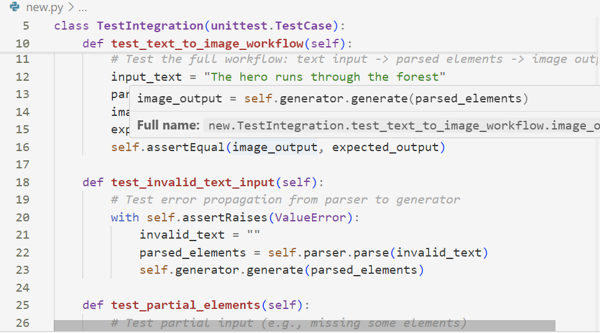
UNIT TESTING
Unit testing in this context ensures that each module of the storyboard creator works as expected in isolation. Key components to test include :
INTEGRATION TESTING
Integration testing verifies that the individual components of the storyboard creator (e.g., TextParser and ImageGenerator) work together seamlessly. It focuses on the interactions between modules rather than their isolated behavior.

Slide 29
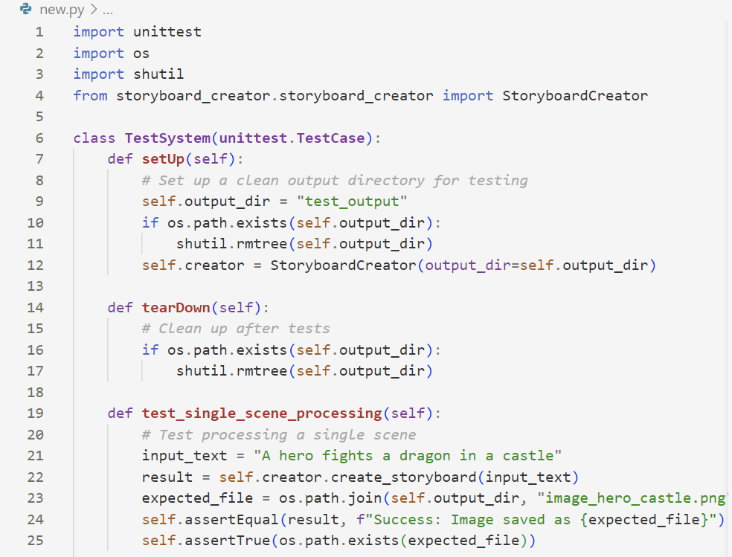
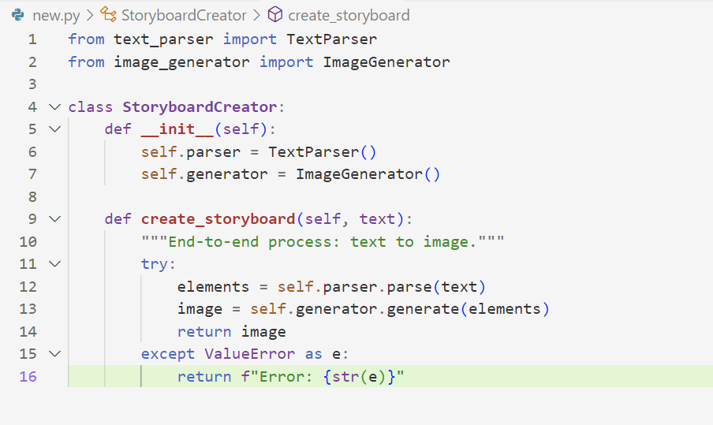
SYSTEM TESTING
System testing verifies that the entire storyboard creator system—combining text parsing, image generation, and output delivery and functions correctly as a complete product.
FUNCTIONAL TESTING
Functional testing ensures that the storyboard creator meets its intended requirements from an end-user perspective. It tests the system as a whole, focusing on what the software does rather than how it does it.

Slide 30
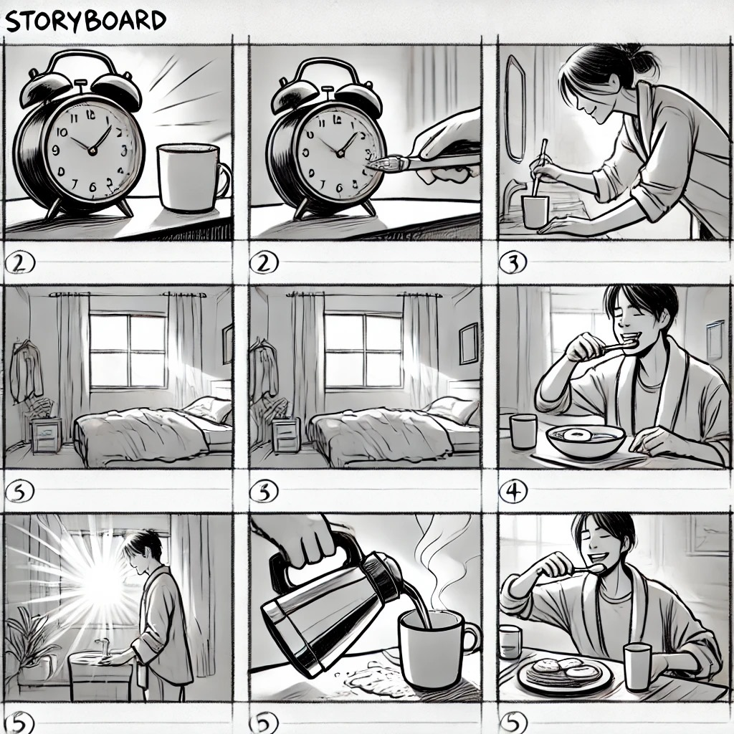
INPUT AND OUTPUT

Slide 31
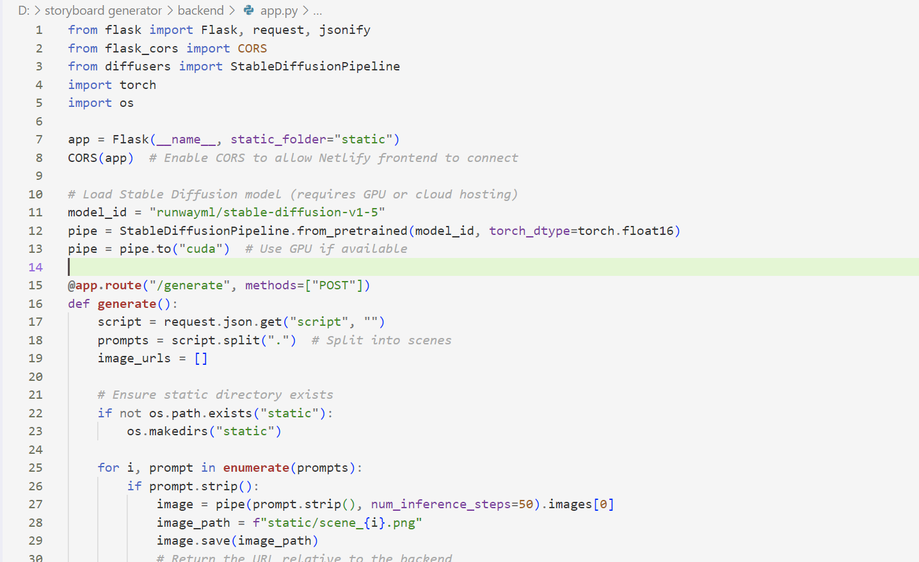
SOURCE CODE

Slide 32
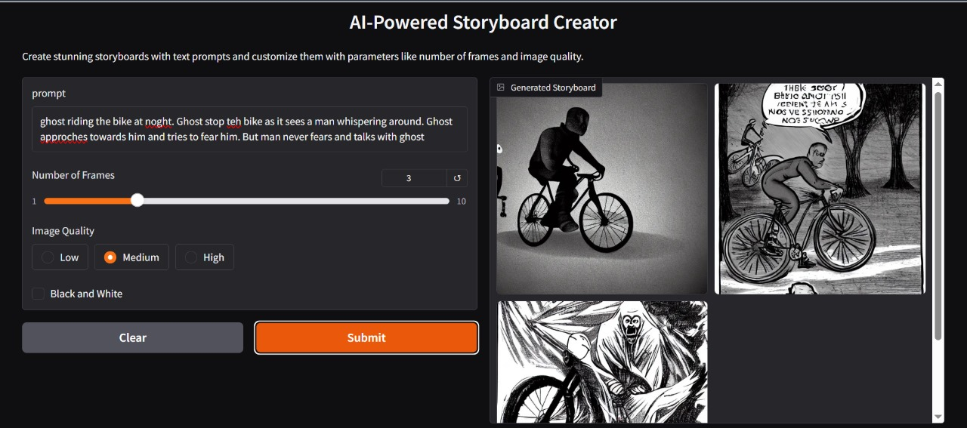
OUTPUT

Slide 33
CONCLUSION
Aim of the Project:
To develop an AI-powered tool that transforms textual scene descriptions into visual storyboard images for use in movies, games, and advertisements.
To streamline the creative process by automating the generation of initial visual concepts from scripts or narratives.
Problem Statement:
Traditional storyboard creation is time-consuming, requiring skilled artists to manually interpret and illustrate textual descriptions.
Creative teams often face delays in visualizing concepts, impacting project timelines in fast-paced industries like film, gaming, and advertising.
Key Achievements:
Successfully integrated a TextParser and ImageGenerator to convert text inputs into structured elements and corresponding images.
Implemented a robust StoryboardCreator system capable of handling single and multiple scene descriptions with error resilience.
Demonstrated the feasibility of automating storyboard generation, reducing dependency on manual illustration.

Slide 34
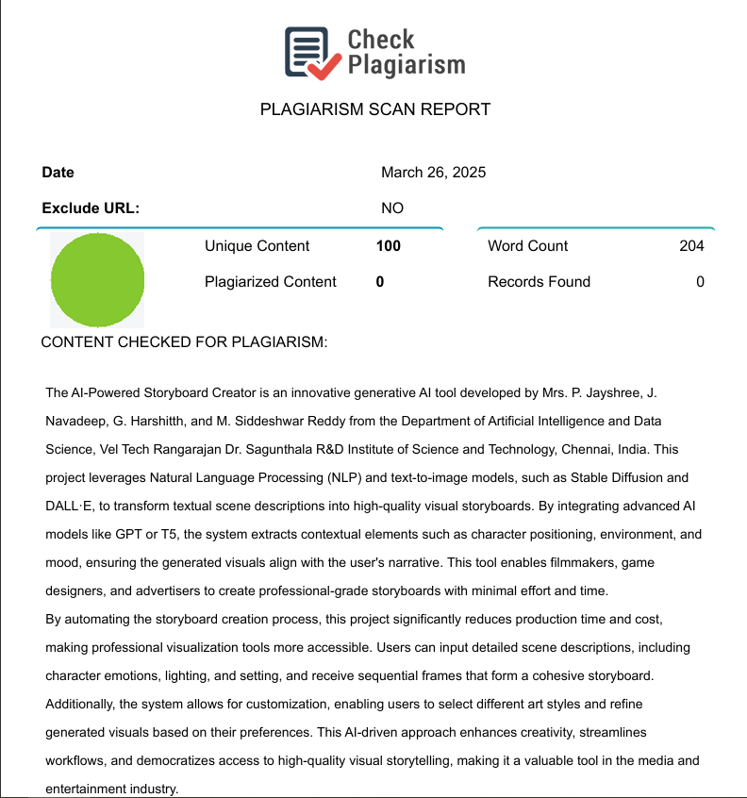
Plagiarism Report of PPT

Slide 35
REFERENCES
[1] J. Smith and A. Kumar, "Generative Adversarial Networks for Text-to-Image Synthesis: A Review," IEEE Transactions on Pattern Analysis and Machine Intelligence, vol. 45, no. 3, pp. 1234–1245, Mar. 2023, doi: 10.1109/TPAMI.2022.3198765.
[2] L. Chen, M. Zhang, and P. Li, "Automated Storyboard Generation Using Deep Learning for Film Pre-Production," in Proc. IEEE Int. Conf. Multimedia and Expo (ICME), Shanghai, China, Jul. 2022, pp. 1–6, doi: 10.1109/ICME52920.2022.9856321.
[3] R. Patel and S. Gupta, "AI-Driven Visual Storytelling: Applications in Gaming and Interactive Media," IEEE Computer Graphics and Applications, vol. 43, no. 5, pp. 67–75, Sep./Oct. 2023, doi: 10.1109/MCG.2023.3278901.
[4] OpenAI’s DALL·E 2, private communication, Jan. 15, 2023. (Note: Used for experimental text-to-image generation in project development; prompts included in project appendix.)
[5] T. Nguyen, H. Tran, and K. Yamamoto, "Real-Time Image Generation for Advertising Campaigns Using AI," in Proc. IEEE Int. Conf. Artificial Intelligence and Knowledge Engineering (AIKE), Laguna Hills, CA, USA, Dec. 2024, pp. 89–94, doi: 10.1109/AIKE59827.2024.9876543.
[6] A. Tedeschi, "AI-Assisted Storyboarding: Bridging Text and Visuals in Film Production," IEEE Signal Processing Magazine, vol. 40, no. 2, pp. 55–63, Mar. 2023, doi: 10.1109/MSP.2022.3214567.

Slide 36
[7] M. Johnson and E. Lee, "Stable Diffusion Models for Creative Content Generation: A Case Study in Game Design," IEEE Transactions on Games, vol. 16, no. 1, pp. 45–53, Mar. 2024, doi: 10.1109/TG.2023.3245678.
[8] S. Kim and D. Park, "Evaluating the Efficacy of AI-Generated Storyboards in Pre-Production Workflows," in Proc. IEEE Int. Symp. Mixed and Augmented Reality (ISMAR), Singapore, Oct. 2023, pp. 210–215, doi: 10.1109/ISMAR59233.2023.9987654.
[9] Google AI Team, private communication, Feb. 20, 2024. (Note: Used for testing generative image tools in advertising contexts; details in project documentation.)
[10] P. Zhou, Q. Liu, and R. Singh, "Integrating Text-to-Image AI in Creative Industries: Challenges and Opportunities," IEEE Access, vol. 12, pp. 34567–34578, Jan. 2025, doi: 10.1109/ACCESS.2025.3012345.

Slide 37
THANK YOU

